Slide 1

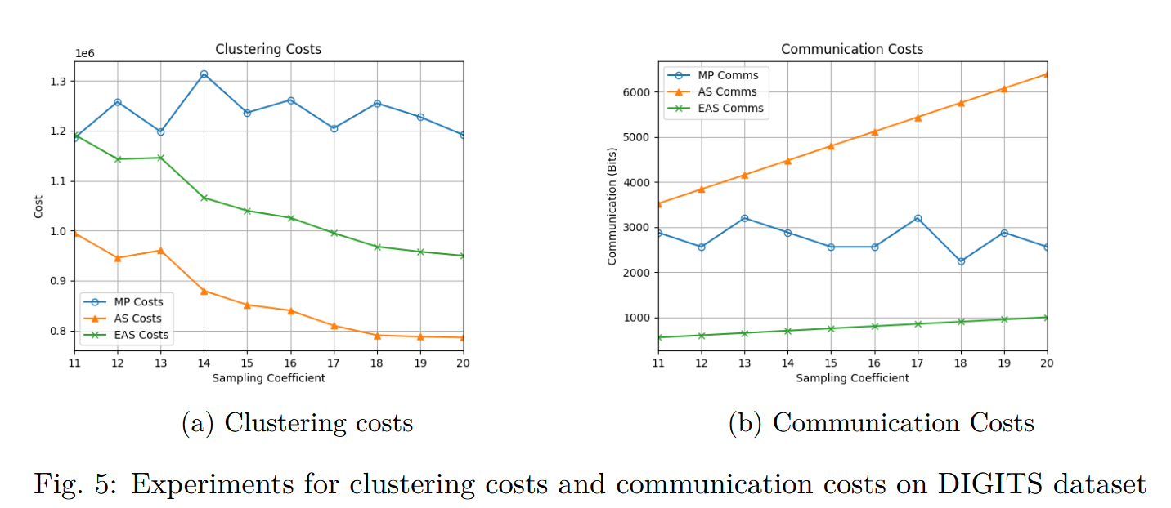
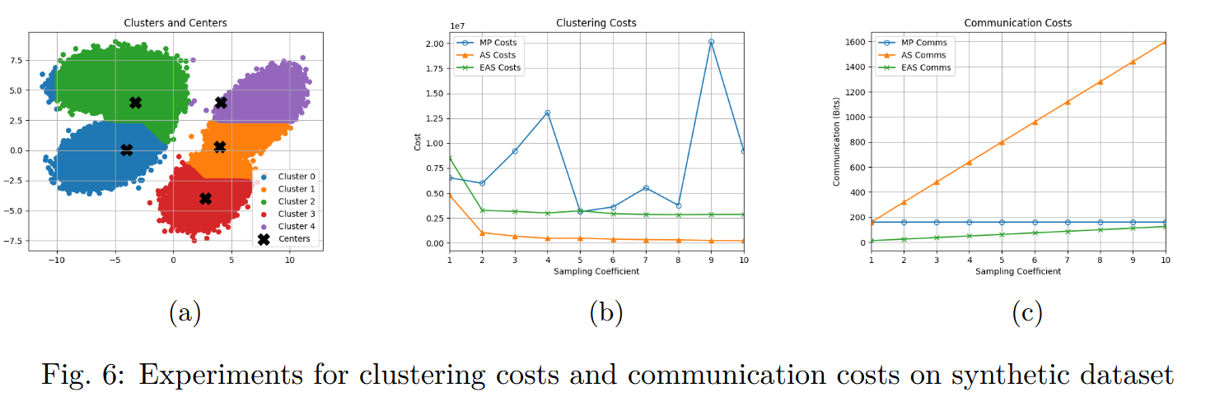
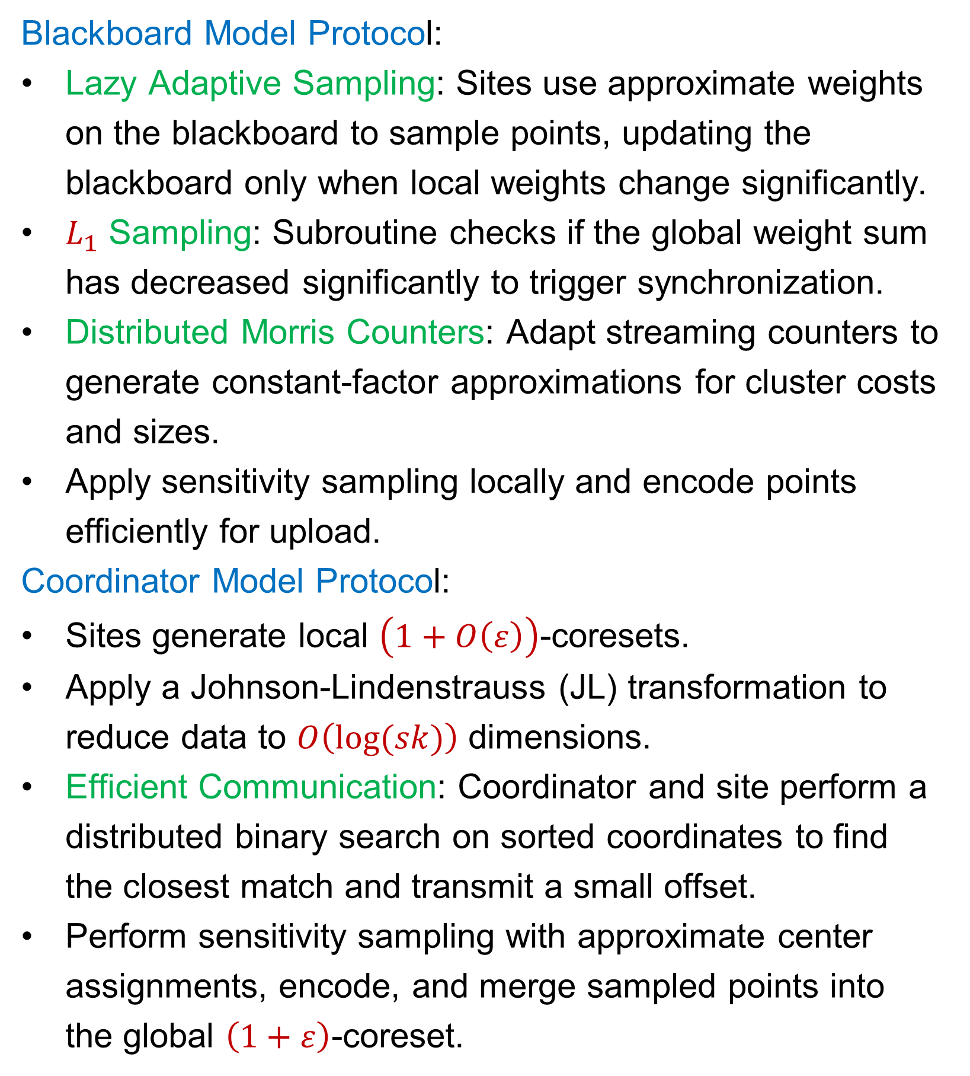
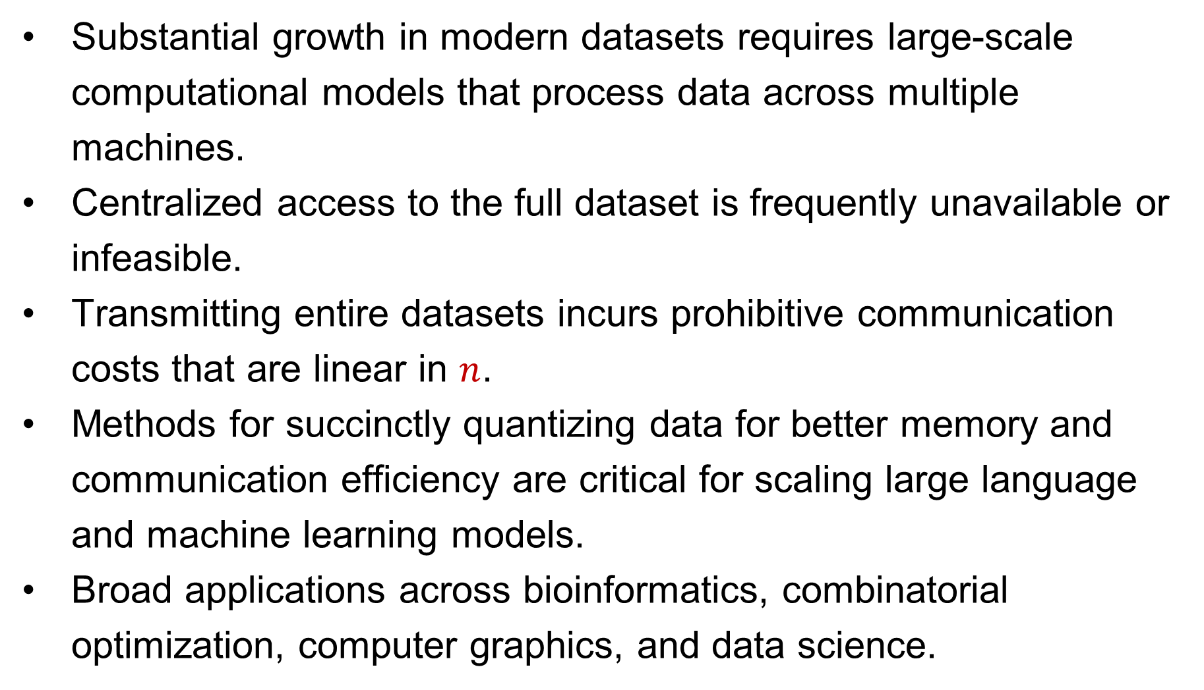
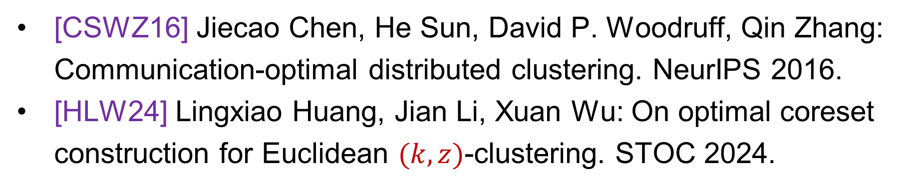
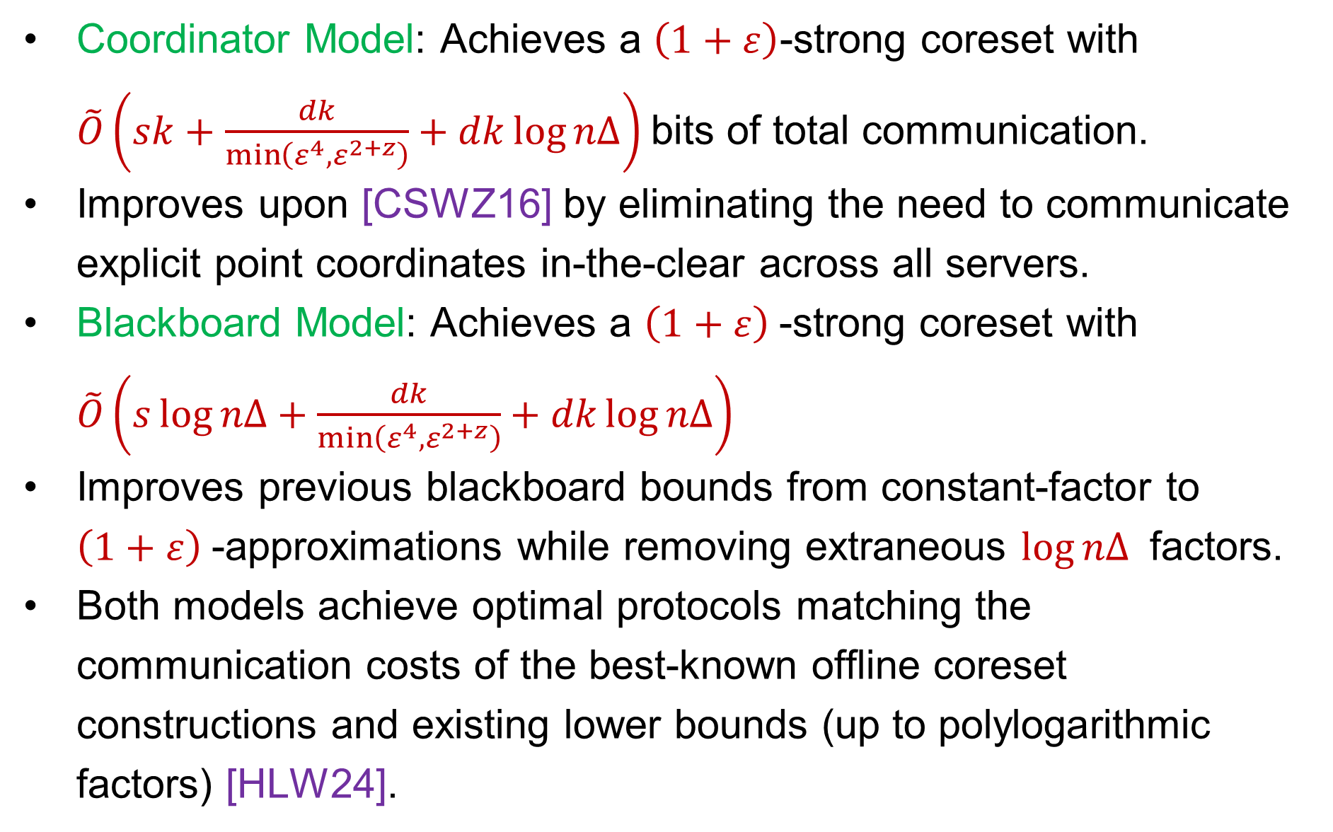
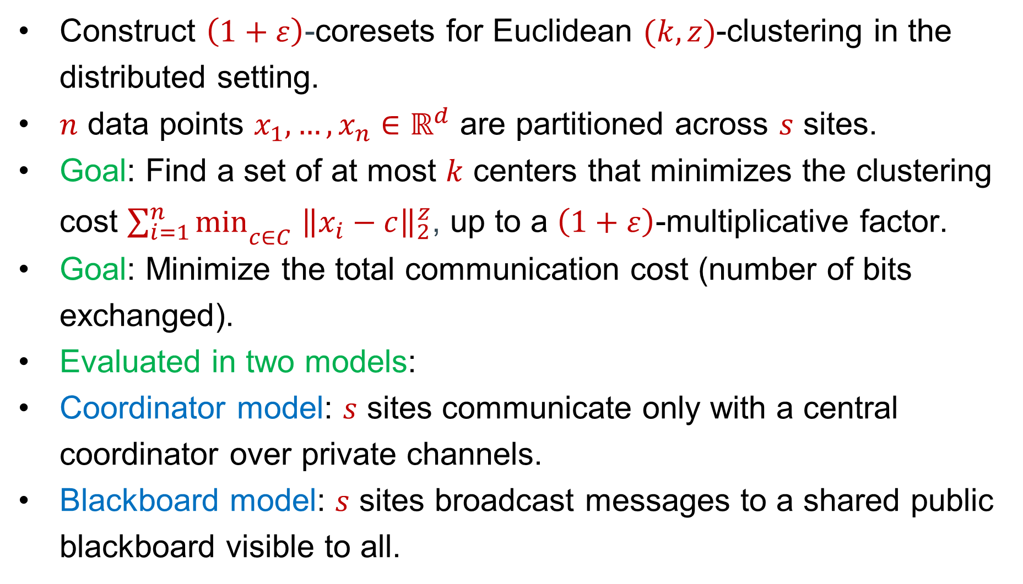
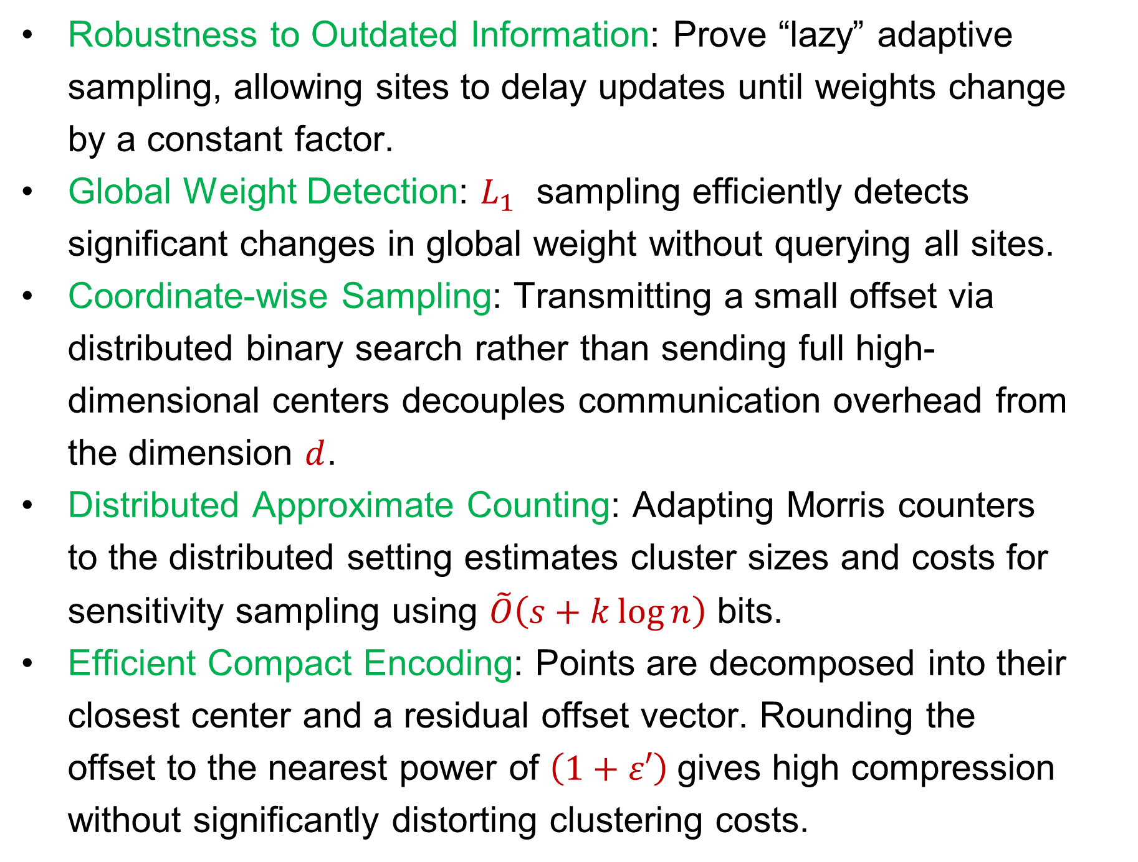
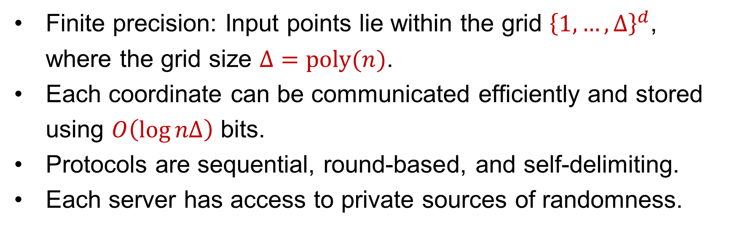
Distributed Algorithms for Euclidean Clustering
Vincent Cohen-Addad (Google Research)
Liudeng Wang (Texas A&M University)
David P. Woodruff (Carnegie Mellon University)
Samson Zhou (Texas A&M University
Algorithm
Blackboard Model Protocol:
Lazy Adaptive Sampling: Sites use approximate weights on the blackboard to sample points, updating the blackboard only when local weights change significantly.
$L_{1}$ Sampling: Subroutine checks if the global weight sum has decreased significantly to trigger synchronization.
Distributed Morris Counters: Adapt streaming counters to generate constant-factor approximations for cluster costs and sizes.
Apply sensitivity sampling locally and encode points efficiently for upload.
Coordinator Model Protocol:
Sites generate local $\left(1+O\left(ε\right)\right)$-coresets.
Apply a Johnson-Lindenstrauss (JL) transformation to reduce data to $O\left(log⁡(sk)\right)$ dimensions.
Efficient Communication: Coordinator and site perform a distributed binary search on sorted coordinates to find the closest match and transmit a small offset.
Perform sensitivity sampling with approximate center assignments, encode, and merge sampled points into the global $\left(1+ε\right)$-coreset.
Problem Statement
Applications / Motivations
Construct $\left(1+ε\right)$-coresets for Euclidean $(k,z)$-clustering in the distributed setting.
$n$ data points $x_{1},…,x_{n}∈ℝ^{d}$ are partitioned across $s$ sites.
Goal: Find a set of at most $k$ centers that minimizes the clustering cost ${\sum_{i=1}^{n}{min}}_{c∈C}$ ${\left\|x_{i}−c\right\|}_{2}^{z}$,​ up to a $\left(1+ε\right)$-multiplicative factor.
Goal: Minimize the total communication cost (number of bits exchanged).
Evaluated in two models:
Coordinator model: $s$ sites communicate only with a central coordinator over private channels.
Blackboard model: $s$ sites broadcast messages to a shared public blackboard visible to all.
Substantial growth in modern datasets requires large-scale computational models that process data across multiple machines.
Centralized access to the full dataset is frequently unavailable or infeasible.
Transmitting entire datasets incurs prohibitive communication costs that are linear in $n$.
Methods for succinctly quantizing data for better memory and communication efficiency are critical for scaling large language and machine learning models.
Broad applications across bioinformatics, combinatorial optimization, computer graphics, and data science.
Assumptions
Results and Related Work
Finite precision: Input points lie within the grid ${\left\{1,…,Δ\right\}}^{d}$, where the grid size $Δ=poly(n)$.
Each coordinate can be communicated efficiently and stored using $O\left(\log{nΔ}\right)$ bits.
Protocols are sequential, round-based, and self-delimiting.
Each server has access to private sources of randomness.
Coordinator Model: Achieves a $\left(1+ε\right)$-strong coreset with $\tilde{O}\left(sk+\frac{dk}{\min\left(ε^{4},ε^{2+z}\right)}+dk\log{nΔ}\right)$bits of total communication.
Improves upon [CSWZ16] by eliminating the need to communicate explicit point coordinates in-the-clear across all servers.
Blackboard Model: Achieves a $\left(1+ε\right)$-strong coreset with $\tilde{O}\left(s\log{nΔ}+\frac{dk}{\min\left(ε^{4},ε^{2+z}\right)}+dk\log{nΔ}\right)$
Improves previous blackboard bounds from constant-factor to $\left(1+ε\right)$-approximations while removing extraneous $\log{nΔ}$ factors.
Both models achieve optimal protocols matching the communication costs of the best-known offline coreset constructions and existing lower bounds (up to polylogarithmic factors) [HLW24].
Technical Contribution / Intuition
Robustness to Outdated Information: Prove “lazy” adaptive sampling, allowing sites to delay updates until weights change by a constant factor.
Global Weight Detection: $L_{1}$ ​ sampling efficiently detects significant changes in global weight without querying all sites.
Coordinate-wise Sampling: Transmitting a small offset via distributed binary search rather than sending full high-dimensional centers decouples communication overhead from the dimension $d$.
Distributed Approximate Counting: Adapting Morris counters to the distributed setting estimates cluster sizes and costs for sensitivity sampling using $\tilde{O}\left(s+k\log{n}\right)$ bits.
Efficient Compact Encoding: Points are decomposed into their closest center and a residual offset vector. Rounding the offset to the nearest power of $\left(1+ε′\right)$gives high compression without significantly distorting clustering costs.
References
[CSWZ16] Jiecao Chen, He Sun, David P. Woodruff, Qin Zhang: Communication-optimal distributed clustering. NeurIPS 2016.
[HLW24] Lingxiao Huang, Jian Li, Xuan Wu: On optimal coreset construction for Euclidean $(k,z)$-clustering. STOC 2024.

